Slide 1
Probability theory and average-case complexity

Slide 2
Review of probability theory

Slide 3
Review of probability theory: outcome
Examples:
Rolling a die and getting 1
Rolling a die and getting 6
Flipping three coins and getting H, H, T
Drawing two cards and getting 7 of hearts, 9 of clubs
NOT examples:
Rolling a 6-sided die and getting an even number (this is more than one outcome—3 to be exact!)
Drawing a card and getting an ace (4 outcomes!)

Slide 4
Review of probability theory: event
Defn: one or more possible outcomes
Examples:
Rolling a die and getting 1
Rolling a die and getting an even number
Flipping three coins and getting at least 2 “heads”
Drawing five cards and getting one of each suit

Slide 5
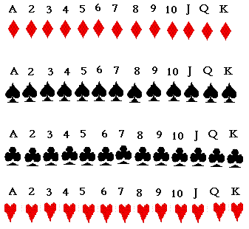
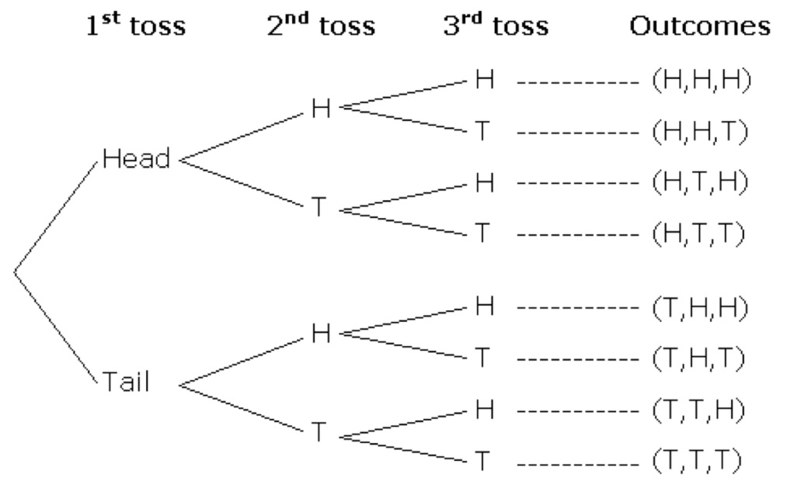
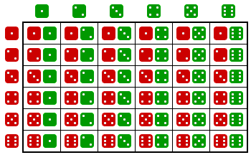
Review of probability theory: sample space
Defn: A set of events
Examples:
Drawing a card
Flipping 3 coins
Rolling 2 dice

Slide 6
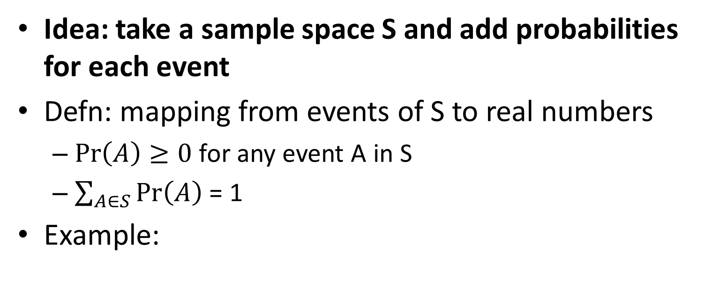
Review of probability theory: probability distribution
Idea: take a sample space S and add probabilities for each event
Defn: mapping from events of S to real numbers
$\operatorname{Pr}\left(A\right)≥0$ for any event A in S
$\sum_{A∈S}{\operatorname{Pr}\left(A\right)}$ = 1
Example:
0.75*0.75
0.75³
0.75
0.75²*0.25
0.75²*0.25
0.75*0.25
0.75*0.25²
Flipping 3 biased coins 75% heads, 25% tails
0.25*0.75
0.75²*0.25
0.25
0.75*0.25²
0.75*0.25²
0.25*0.25
0.25³

Slide 7

Review of probability theory: probability of an event A
Defn: $\operatorname{Pr}\left(A\right)=\sum_{outcome∈A}{\operatorname{Pr}\left(outcome\right)}$
Example:
Pr(roll a die and get even number) = Pr(roll a 2) + Pr(roll a 4) + Pr(roll a 6)

Slide 8
Review of probability theory: random variable
Idea: turn events into numbers
Let S be a sample space
Defn: mapping from events to real numbers
Example:
X = the number on a die after a roll event “rolling a 1” -> 1 event “rolling a 2” -> 2 … event “rolling a 6” -> 6
Technically, X is a function, so we can write: X(rolling a 1) = 1
X(rolling a 2) = 2 … X(rolling a 6) = 6

Slide 9
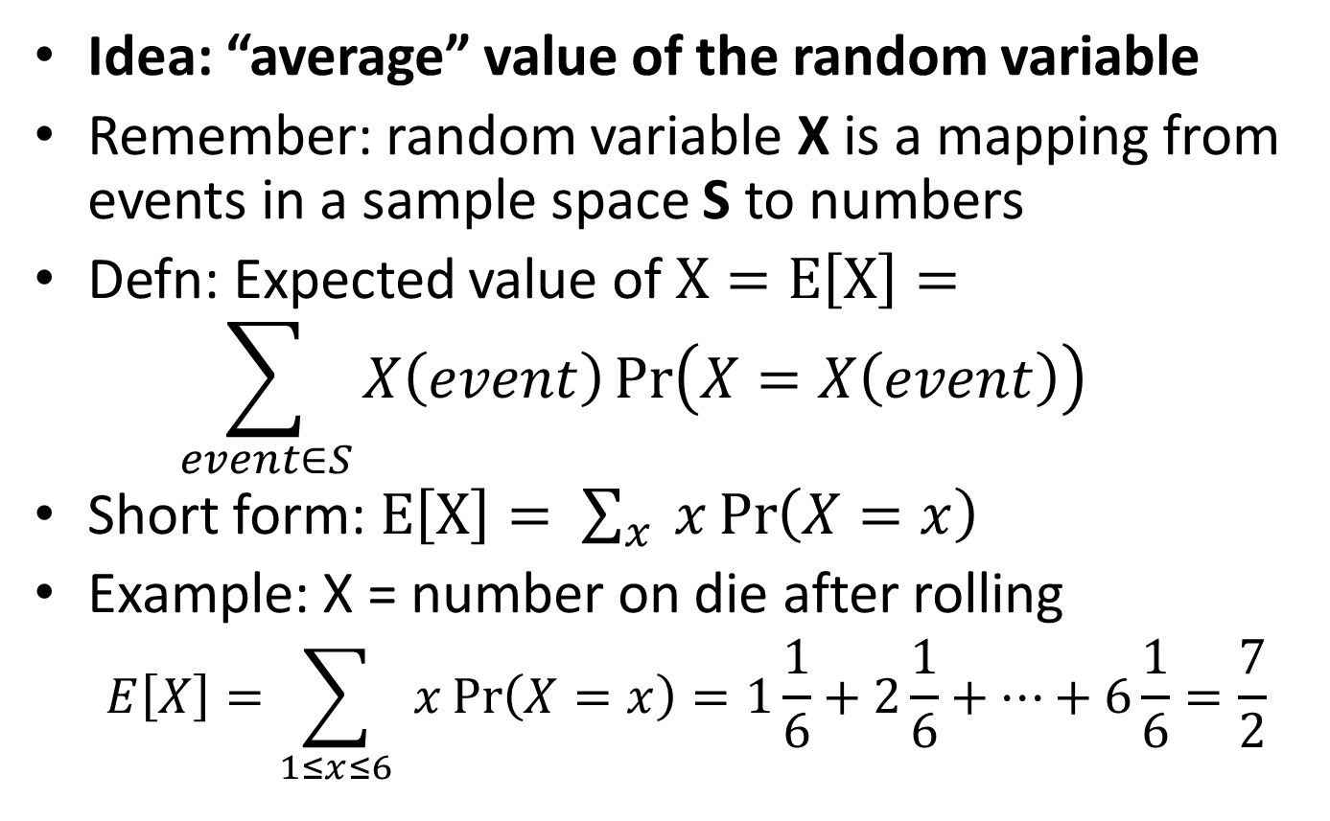
Review of probability theory: expected value of a random variable
Idea: “average” value of the random variable
Remember: random variable X is a mapping from events in a sample space S to numbers
Defn: Expected value of $X=E\left[X\right]=$ $\sum_{event∈S}{X\left(event\right)\operatorname{Pr}\left(X=X\left(event\right)\right) }$
Short form: $E\left[X\right]= \sum_{x}{ x\operatorname{Pr}\left(X=x\right)}$
Example: X = number on die after rolling
$$E\left[X\right]=\sum_{1≤x≤6}{ x\operatorname{Pr}\left(X=x\right)}=1\frac{1}{6}+2\frac{1}{6}+…+6\frac{1}{6}=\frac{7}{2}$$
Here, x = X(event)

Slide 10
Expected running time of an algorithm

Slide 11
Expected running time of an algorithm
Let A be an algorithm.
Let S_{n} be the sample space of all inputs of size n.
To talk about expected (/average) running time, we must specify how we measure running time.
We want to turn each input into a number (runtime).
Random variables do that…
We must also specify how likely each input is.
We do this by specifying a probability distribution over S_{n.}

Slide 12
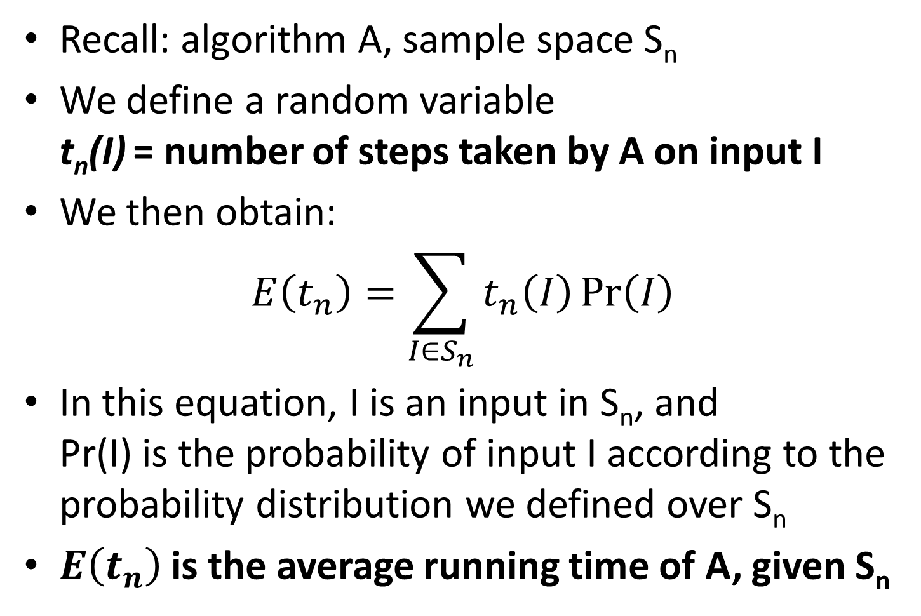
Expected running time of an algorithm
Recall: algorithm A, sample space S_{n}
We define a random variable t_{n}(I) = number of steps taken by A on input I
We then obtain: $E\left(t_{n}\right)=\sum_{I∈S_{n}}{t_{n}\left(I\right)\operatorname{Pr}\left(I\right)}$
In this equation, I is an input in S_{n}, and Pr(I) is the probability of input I according to the probability distribution we defined over S_{n}
$E\left(t_{n}\right)$ is the average running time of A, given S_{n}

Slide 13
Example time!

Slide 14
Example time: searching an array
Let L be an array containing 8 distinct keys
Search(k, L[1..8]):
for i = 1..8
if L[i].key == k then return true
return false
What should our sample space S₉ of inputs be?
Hard to reason about all possible inputs.
(In fact, there are uncountably infinitely many!)
Can group inputs by how many steps they take!

Slide 15
Grouping inputs by how long they take
Search(k, L[1..8]):
for i = 1..8
if L[i].key == k then return true
return false
What causes us to return in loop iteration 1?
How about iteration 2? 3? … 8? After loop?
S₉ = { L[1]=k, L[2]=k, …, L[8]=k, k not in L }
Now we need a random variable for S₉!

Slide 16
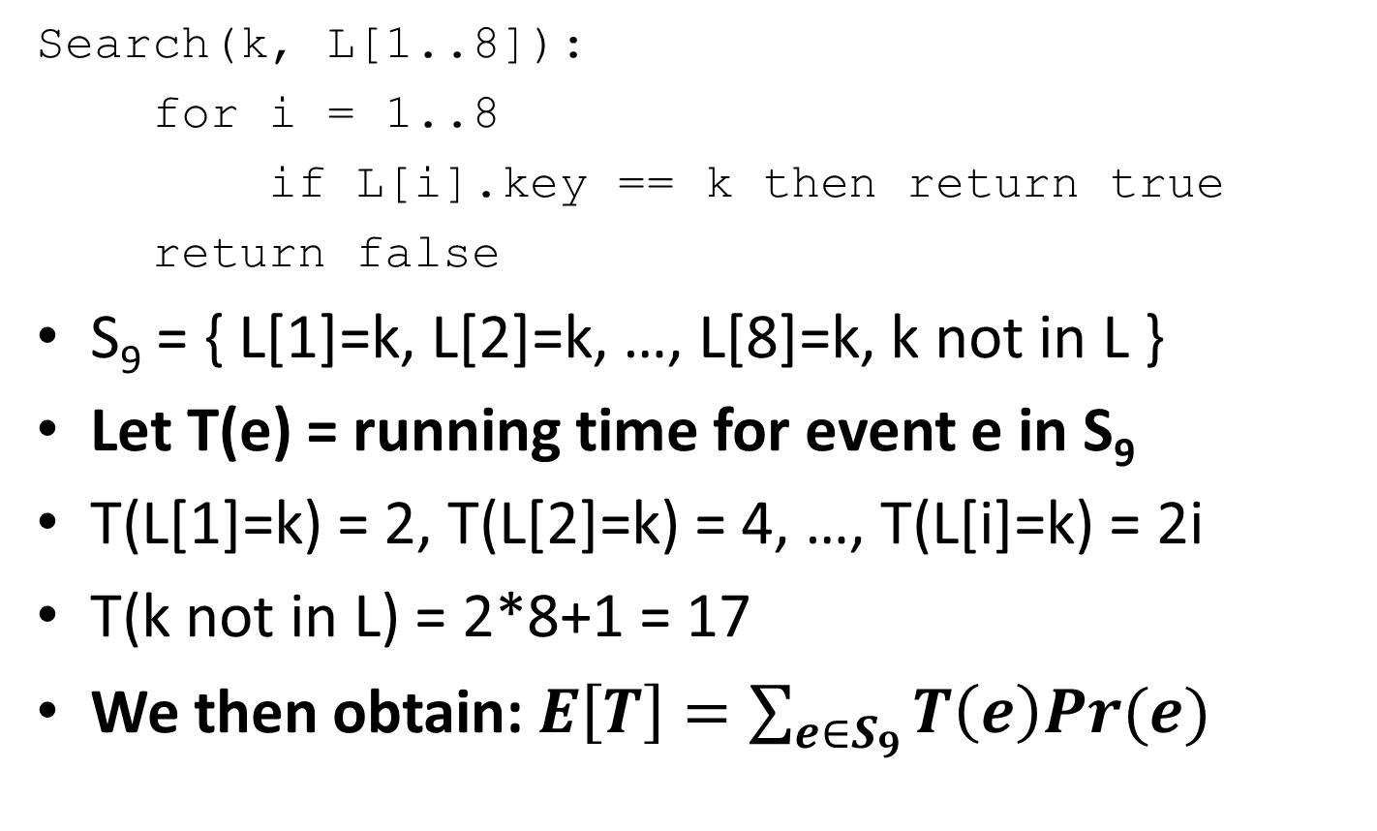
Using a random variable to capture running time
Search(k, L[1..8]):
for i = 1..8
if L[i].key == k then return true
return false
S₉ = { L[1]=k, L[2]=k, …, L[8]=k, k not in L }
Let T(e) = running time for event e in S₉
T(L[1]=k) = 2, T(L[2]=k) = 4, …, T(L[i]=k) = 2i
T(k not in L) = 2*8+1 = 17
We then obtain: $E\left[T\right]=\sum_{e∈S_{9}}{T\left(e\right)Pr(e)}$
Do we have enough information to compute an answer?
For simplicity: assume each iteration takes 2 steps.
1 step

Slide 17
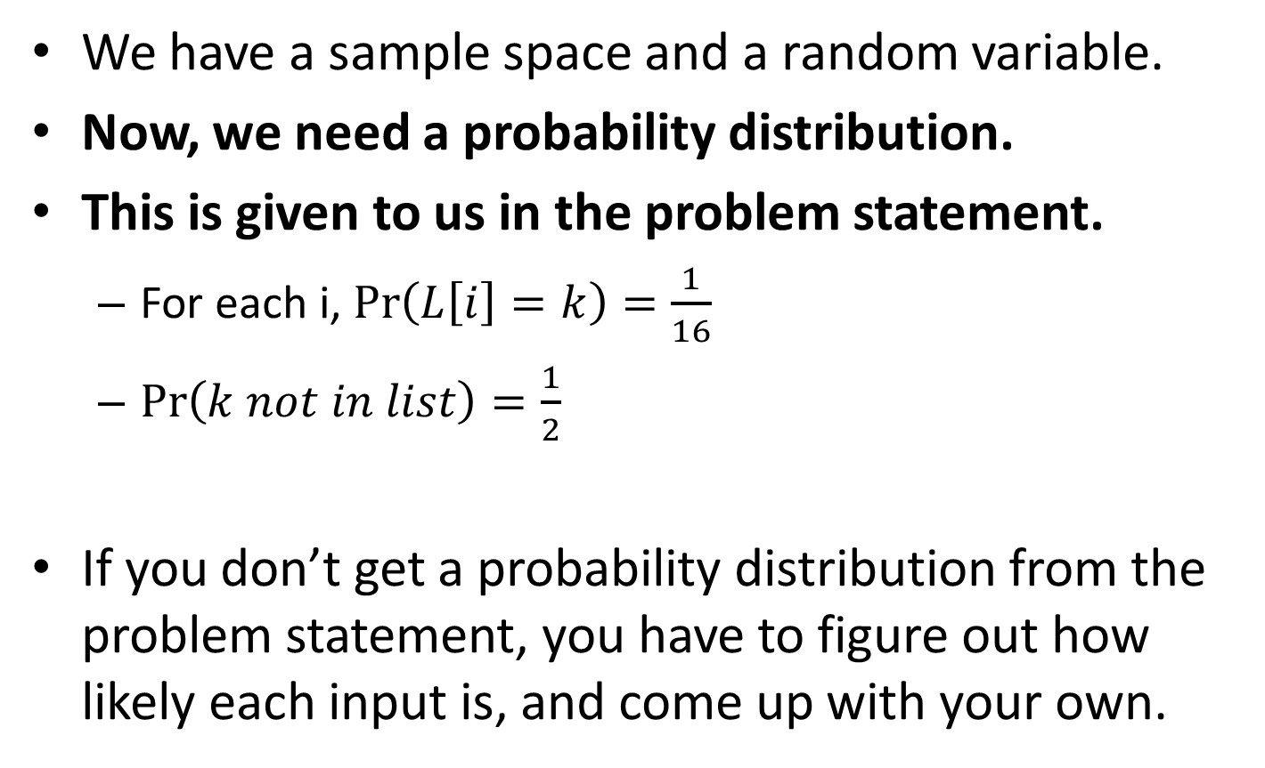
What about a probability distribution?
We have a sample space and a random variable.
Now, we need a probability distribution.
This is given to us in the problem statement.
For each i, $\operatorname{Pr}\left(L\left[i\right]=k\right)=\frac{1}{16}$
$\operatorname{Pr}\left(k not in list\right)=\frac{1}{2}$
If you don’t get a probability distribution from the problem statement, you have to figure out how likely each input is, and come up with your own.

Slide 18
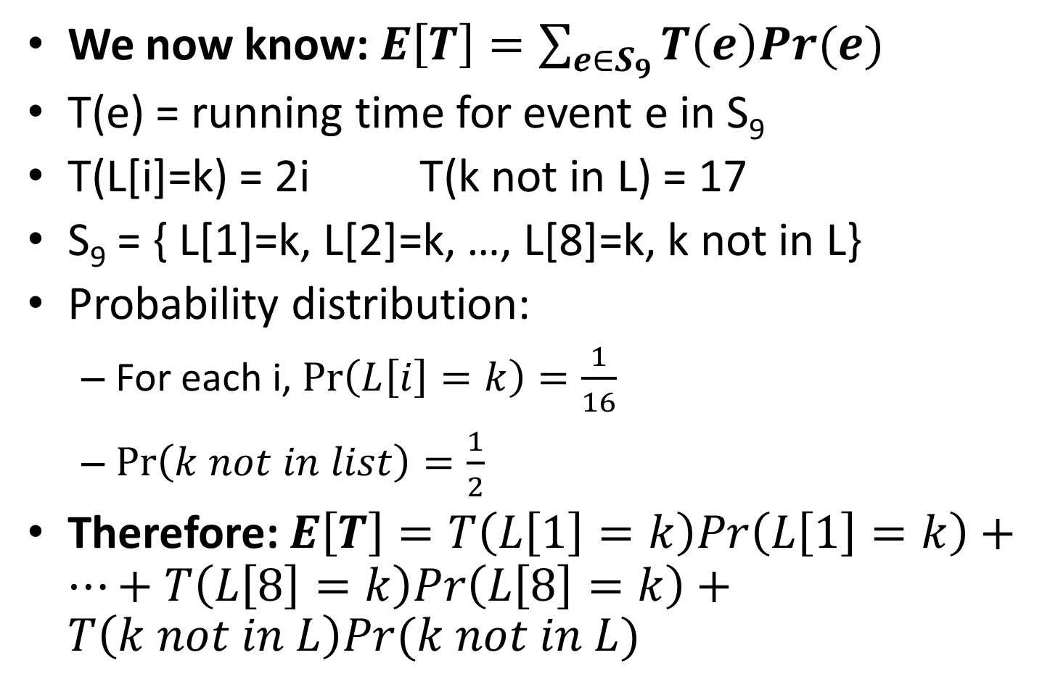
Computing the average running time
We now know:$E\left[T\right]=\sum_{e∈S_{9}}{T\left(e\right)Pr(e)}$
T(e) = running time for event e in S₉
T(L[i]=k) = 2i T(k not in L) = 17
S₉ = { L[1]=k, L[2]=k, …, L[8]=k, k not in L}
Probability distribution:
For each i, $\operatorname{Pr}\left(L\left[i\right]=k\right)=\frac{1}{16}$
$\operatorname{Pr}\left(k not in list\right)=\frac{1}{2}$
Therefore: $E\left[T\right]=T\left(L\left[1\right]=k\right)Pr\left(L\left[1\right]=k\right)+…+T\left(L\left[8\right]=k\right)Pr\left(L\left[8\right]=k\right)+T\left(k not in L\right)Pr(k not in L)$

Slide 19
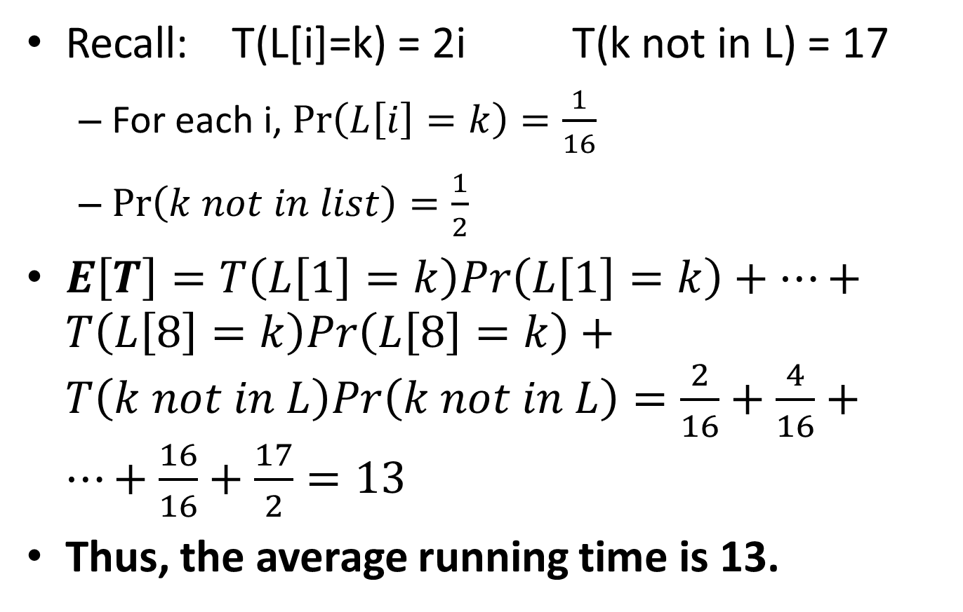
The final answer
Recall: T(L[i]=k) = 2i T(k not in L) = 17
For each i, $\operatorname{Pr}\left(L\left[i\right]=k\right)=\frac{1}{16}$
$\operatorname{Pr}\left(k not in list\right)=\frac{1}{2}$
$E\left[T\right]=T\left(L\left[1\right]=k\right)Pr\left(L\left[1\right]=k\right)+…+T\left(L\left[8\right]=k\right)Pr\left(L\left[8\right]=k\right)+T\left(k not in L\right)Pr\left(k not in L\right)=\frac{2}{16}+\frac{4}{16}+…+\frac{16}{16}+\frac{17}{2}=13$
Thus, the average running time is 13.

Slide 20
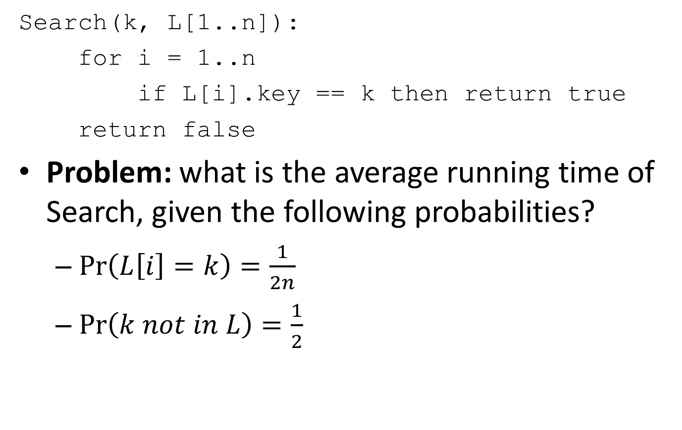
Slightly harder problem: L[1..n]
Search(k, L[1..n]):
for i = 1..n
if L[i].key == k then return true
return false
Problem: what is the average running time of Search, given the following probabilities?
$\operatorname{Pr}\left(L\left[i\right]=k\right)=\frac{1}{2n}$
$\operatorname{Pr}\left(k not in L\right)=\frac{1}{2}$

Slide 21
Computing E[T]: part 1
Search(k, L[1..n]):
for i = 1..n
if L[i].key == k then return true
return false
What is our sample space?
S_{n+1} = { L[1]=k, L[2]=k, …, L[n]=k, k not in L }
What is our random variable?
Let T(e) = running time for event e in S_{n+1}
What is the running time of each event?
T(L[i]=k) = 2i, T(k not in L)=2n+1

Slide 22
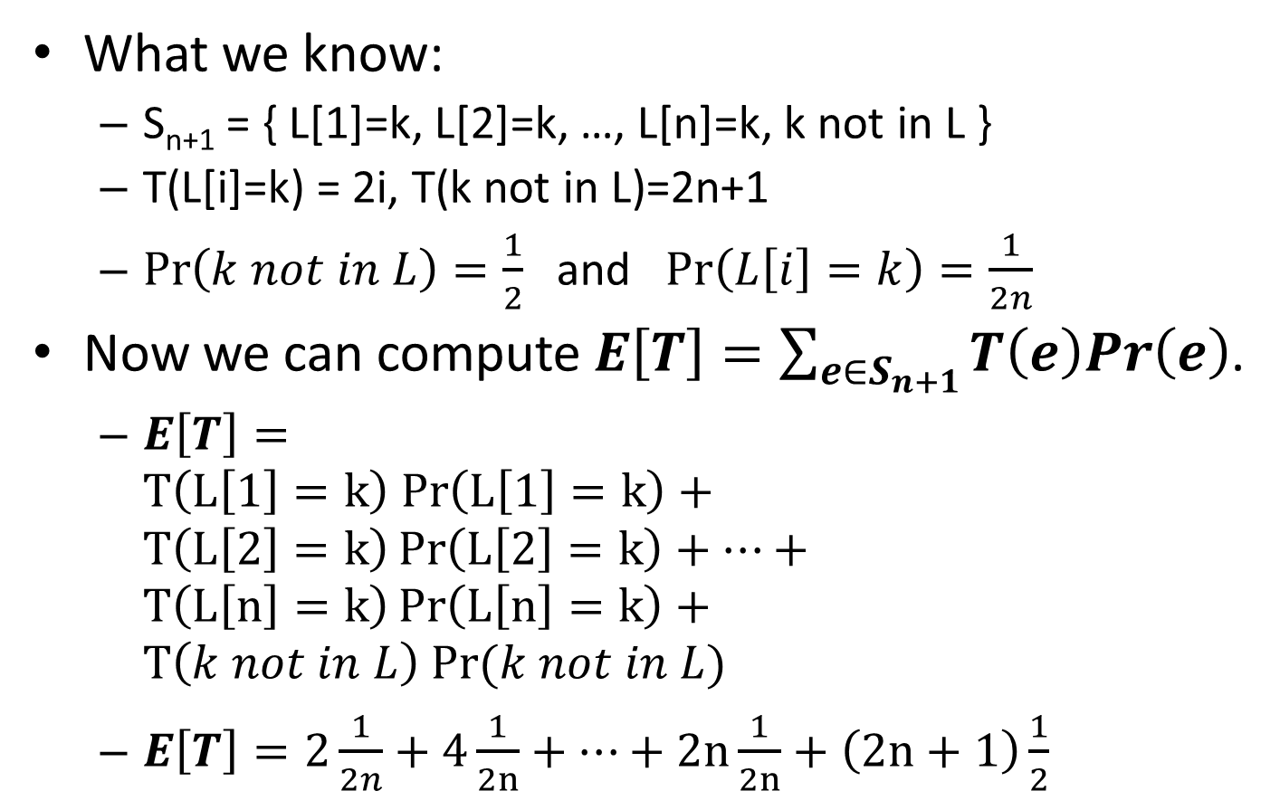
Computing E[T]: part 2
What we know:
S_{n+1} = { L[1]=k, L[2]=k, …, L[n]=k, k not in L }
T(L[i]=k) = 2i, T(k not in L)=2n+1
$\operatorname{Pr}\left(k not in L\right)=\frac{1}{2}$ and $\operatorname{Pr}\left(L\left[i\right]=k\right)=\frac{1}{2n}$
Now we can compute $E\left[T\right]=\sum_{e∈S_{n+1}}{T\left(e\right)Pr\left(e\right)}$.
$E\left[T\right]=T\left(L\left[1\right]=k\right) Pr\left(L\left[1\right]=k\right)+T\left(L\left[2\right]=k\right)\operatorname{Pr}\left(L\left[2\right]=k\right)+…+T\left(L\left[n\right]=k\right)\operatorname{Pr}\left(L\left[n\right]=k\right)+T\left(k not in L\right) Pr⁡(k not in L)$
$E\left[T\right]=2\frac{1}{2n}+4\frac{1}{2n}+…+2n\frac{1}{2n}+\left(2n+1\right)\frac{1}{2}$

Slide 23
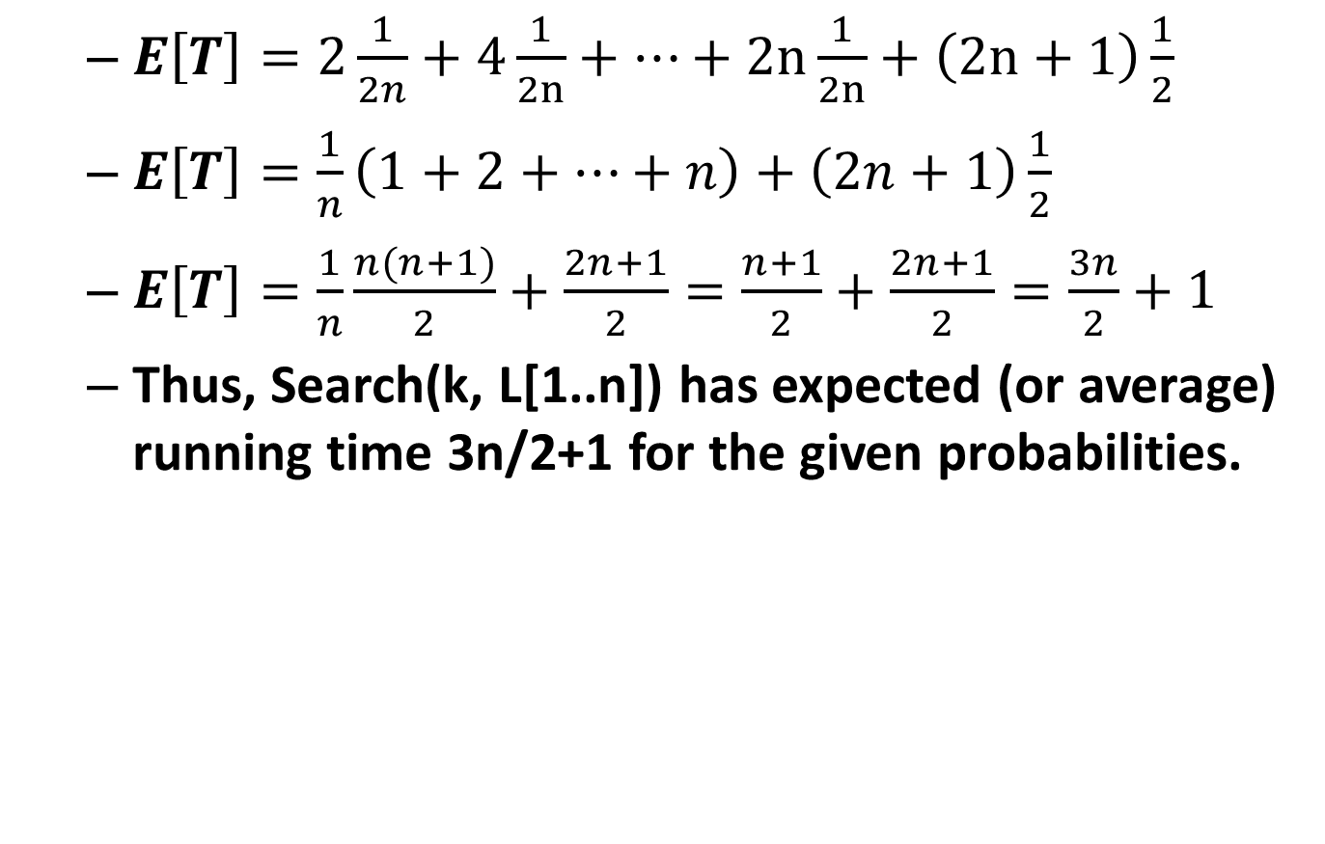
Computing E[T]: part 3
$E\left[T\right]=2\frac{1}{2n}+4\frac{1}{2n}+…+2n\frac{1}{2n}+\left(2n+1\right)\frac{1}{2}$
$E\left[T\right]=\frac{1}{n}\left(1+2+…+n\right)+\left(2n+1\right)\frac{1}{2}$
$E\left[T\right]=\frac{1}{n}\frac{n(n+1)}{2}+\frac{2n+1}{2}=\frac{n+1}{2}+\frac{2n+1}{2}=\frac{3n}{2}+1$
Thus, Search(k, L[1..n]) has expected (or average) running time 3n/2+1 for the given probabilities.

